Slide 1
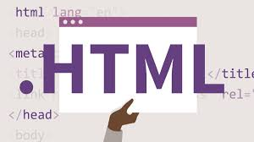

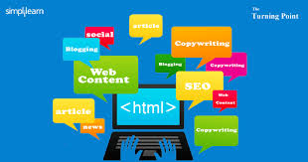

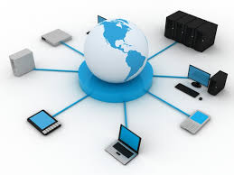


Networking Concepts Template
A Hyperlink Presentation
By: Pritpal Jangla, Amrit Shoker,
Harman Goraya and, Jaskaran Dhaliwal

Slide 2

Table of Contents
Some Useful Documentation
Some Basic Concepts
Web Servers & Web Pages
Domain Names & IP Addresses
Mail Servers & Other Types of Servers
Network Routing & ISPs
Local Area & Wide Area Networks & VPNs

Slide 3


1) Some Useful Documentation
How to use Hyperlinks in PowerPoint
https://www.ispringsolutions.com/blog/user-guide-for-non-linear-presentations
Home

Slide 4
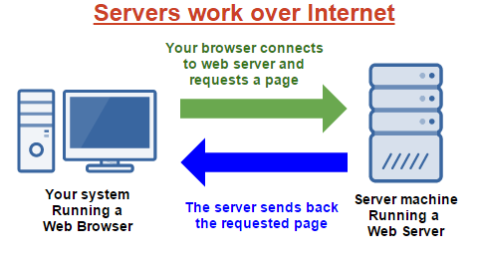

2) Some Basic Concepts
By: Pritpal
Jangla
Section Topics
Client Server Model
Peer-To-Peer Model
Hyperlinks
Packets & Data
Firewalls
Basic Concepts
Home

Slide 5
2.1) Client Server Model
By: Pritpal
Jangla
Explain the Client Server Model
What is the Client
The client is the service requester.
A client does not provide any resources but requests a servers content or service function.
What is the Server
The server provides clients with a service or resources.
The server may charge the client money for the usage of the servers services
Provide an example of an application that uses the Client Server Model
Client: Desktop Computer Server: Browser
Basic Concepts
Home

Slide 6
2.2) Peer-To-Peer Model
By: Pritpal
Jangla
Explain the Peer-To-Peer Model
What is a Peer
Peers are computer systems which are connected to each other by the internet.
Files can be shared to each other without a central server.
Any computer on a P2P network becomes both a file server and client.
How is it different from a Client Server Model
A P2P network has no central servers but a Client Server Model centralizes all of its data.
Provide an example of an application that uses the Peer-To-Peer Model
Xunlei, bittorrent, Utorrent, Azureus, Emule and eDonkey.
Basic Concepts
Home

Slide 7
2.3) Hyperlinks
By: Pritpal
Jangla
What is a Hyperlink?
A hyperlink is a word, image, or graphic a user can click which will lead them to another site.
A hyperlink points to a whole document or a specific element within the document.
How are Hyperlink related to Web Pages?
Web pages are written in the hypertext language called HTML.
Web pages links start with HTML.
How are Hyperlinks related to this PowerPoint document?
At the bottom right corner of each slide there is a hyperlink which redirects you to another slide within the google slides.
Basic Concepts
Home

Slide 8
2.4) Packets & Data
By: Pritpal
Jangla
What is a Data Packet?
A data packet is a unit of data made into a single package that travels along a given network path.
The packet consists of the users data and control information which is also known as the payload.
What happens to a message (or data) when it is sent across the Internet?
If the message is long, it is broken up into small pieces which are called packets.
This is because data which is sent over the internet are sent in manageable chunks.
Basic Concepts
Home

Slide 9
2.5) Firewalls
By: Pritpal
Janglac
What is a Firewall?
A firewall is a barrier between a trusted internal network and a untrusted external internet.
An example of this would be the internet.
How does a Firewall protect your computer?
A firewall blocks unauthorized access to your computer.
This saves you from viruses and hackers.
Firewalls help protect your confidential files and information which may be at risk to other unauthorized people.
How does a Firewall protect remote servers?
The purpose of a firewall is to reduce or eliminate the occurrence of unwanted network communications while allowing all legitimate communication to flow freely.
Basic Concepts
Home

Slide 10
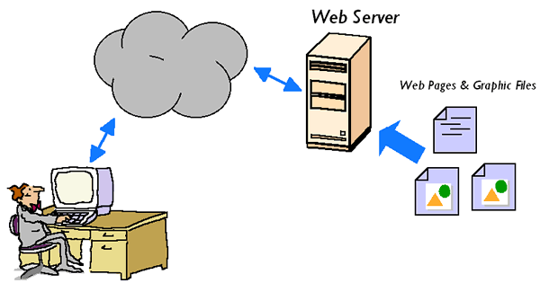

3) Web Servers & Web Pages
By: Jaskaran Dhaliwal
Section Topics
HTML
Browsing A Web Page
Web Client Hardware & Software
Web Server Hardware & Software
Web Servers
Home

Slide 11
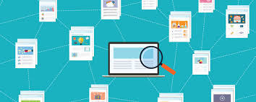
3.1) HTML & Web Pages
By: Jaskaran Dhaliwal
What does HTML stand for?
It stands for Hypertext Markup Language.
How is HTML related to Web Pages?
HTML is the programing language used to make web pages.
HTML allows web pages to have images, data, text , graphics and etc on the internet.
What are some examples of HTML tags used in Web Pages?
Some examples are </p>, </html>, </head> and etc.
These are used to format the webpage and organize everything on the page.
What are some other languages used in Web Pages?
Other languages that are used to make web pages are JavaScript, Cascading Style Sheets and etc.
Web Servers
Home

Slide 12
3.2) Browsing a Web Page By: Harman Goraya
What happens when you browse a web page?
What are the main steps?
Browser goes to the DNS server and finds the real address of the server
Browser sends a HTTP request message to the server, asking to send a copy of the website to the client. The message, and all other data sent between the client and the server, is sent across your internet connection using TCP/IP.
If the server approves the client’s request, the server sends the client a “200 OK” message. It just means in simple words “Yeah of course you can look at the website, and here it is”. It starts sending the website’s files to the browser as a series of small chunks called data packets.
The browser assembles assembles the small chunks into a complete website and displays it to you.
Web Servers
Home

Slide 13
3.3) Web Client Hardware & Software
By: Jaskaran Dhaliwal
What does a Web Browser do?
A web browser allows the computer user to access the World Wide Web or the internet.
What are some common web browsers?
How are they different?
Some common browsers are Google Chrome, MIcrosoft Edge and etc.
They are different as Edge is faster than Chrome but Chrome is more users friendly and simple.
Chrome uses Google as primary search engine and Edge uses Bing.
What are some other types of Web Clients?
Some web clients are Google, Bing, Yahoo and etc.
Is there any special Hardware or Software required to run a web client?
These clients can run on Windows 10, Mac and Linux.
Some clients may not be able to perform to their capability in other OSs.
Web Servers
Home

Slide 14
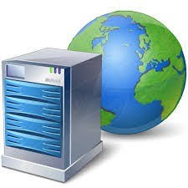
3.4) Web Server Hardware & Software
By: Jaskaran Dhaliwal
What does a Web Server do?
A web server stores, processes and delivers web pages to internet users.
Where are Web Servers located in the Network / Internet?
Web servers are located in the internet as http servers but at their core, they are a computer that stores HTML needed for the web page.
What special Software is needed for a Web Server
A special software required is an TCP/IP software to setup the server.
Another one is a software for the web server platform to hold the web server.
What special Hardware is needed for a Web Server
A very fast computer with very fast internet is needed to make a web server.
Home
Web Servers

Slide 15
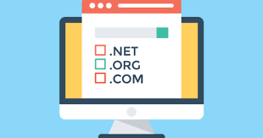
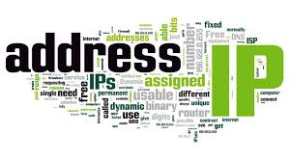
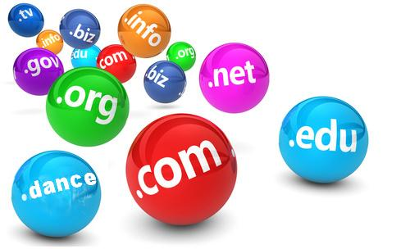

4) Domain Names & IP Addresses
By: Jaskaran Dhaliwal
Section Topics
What is a Domain Name?
What is an IP Address?
Controls the assignment of Names & Addresses?
Domain Names
Home

Slide 16

4.1) What is a Domain Name?
By: Jaskaran Dhaliwal
What is a Domain Name?
Strings of letters used to name organizations and computers and addresses on the internet.
How are Domain Names related to Web Pages?
A domain name is a Website and the web pages are part of that website.
Web pages are often extension to the domain URL.
In short, if the domain name is a tree then the web pages are its leafs.
How does my computer find and use Domain Names?
Each domain name has an IP address and the computer is able to use the IP address and search servers to locate and use the Website.
The computer uses the internet servers and if the domain has an ending relating to a country like .ca or .co.uk, then the server that computer searches are more local and national.
This process is called the DNS(Domain Name System).
Domain Names
Home

Slide 17
4.2) What is an IP Address?
By: Jaskaran Dhaliwal
What is an IP Address?
It's a network address for your computer so you can connect to the internet and send or receive data.
What is the difference between IPv4 and IPv6?
The difference is that the IPv6 will be able to have more IP addresses because the IP addresses will be made with 128-bit rather than th 32-bit IPv4.
How does my computer convert a Domain Name to an IP Address?
The computer uses the DNS, which is a Domain Name Server.
The computer locks up the Domain name in the DNS until it finds the matching IP address.
Domain Names
Home

Slide 18

4.3) Who Controls Domain Names?
By: Jaskaran Dhaliwal
Who Owns and Controls Domain Names and IP Addresses?
All the IP addresses are controlled by the Internet Assigned Numbers Authority (IANA).
The IANA is a non profit organization that oversees all IP address allocations.
They also manage DNS roots.
How can I register a Domain Name for my own use?
Getting a domain name involves registering the name you want with an organisation called ICANN through a domain name registrar.
Some examples of domain name registrar are GoDaddy and etc.
This process often costs money.
Domain Names
Home

Slide 19
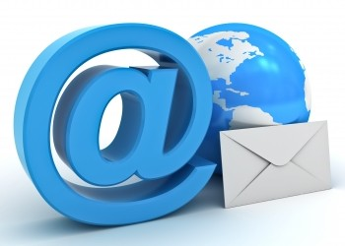

5) Mail & Other Servers
Amrit Shoker
Section Topics
Mail Servers
File Servers
Database Servers
Other Types of Servers
Servers
Home

Slide 20
5.1) Mail Servers
Amrit Shoker
Downloaded Mail
What is SMTP / POP3?
SMTP stands for Simple Mail Transfer Protocol and is used for sending and delivering mail from a pc to a server and get them to another pc. POP stands for Post Office Protocol and it allows the user of a pc to pick up the message sent via another pc and download it into its own inbox for viewing. POP3 is the latest version of the Post Office Protocol, and it’s been used since 1996; it uses port 110.
What are some common Mail Clients
#1 Gmail
#2 Apple iPhone
#3 Outlook
#4 Apple iPad
#5 Apple Mail
#6 Yahoo! Mail
#7 Google Android
#8 Outlook.com
#9 Samsung Mail
#10 Thunderbird
What are some advantages of downloaded mail?
Its a 2 way communication between the client and server and allows many devices to work on a project together.
Emails are always on the server so they can be accessed by any device with an internet connection
It’s possible to recover the emails if they are lost by one pc
Doesn’t use local space since it isn’t directly downloaded to the device
Possible to manage files from server
You can search through all mail using keywords
Servers
Home

Slide 21
5.1) Mail Servers
Amrit Shoker
Web Based Mail
What are some common Browser Based Mail Services
Gmail
AOL.
Outlook.
Zoho.
Mail.com.
Yahoo! Mail.
ProtonMail.
What are some advantages of browser based mail?
convenience
no cost
large storage

Slide 22
5.1) Mail Servers
Amrit Shoker
Mail Servers
Where is mail stored in the Internet?
mail is stored in a servers personal account for everyone
How is mail delivered across the Internet?
Internet emails require an internet connection and access to a mail server from a device the SMTP is used to send and receive emails
What special Hardware & Software is required for a mail server?
there aren’t many websites listing the min and max requirements for an email server

Slide 23
5.2) File Servers
Amrit Shoker
Cloud Based Storage
What are some Cloud Storage Services (applications) ?
IDrive cloud storage
pCloud cloud storage
Zoolz cloud storage
Degoo cloud storage
Mega cloud storage
OneDrive cloud storage
iCloud cloud storage
Google Drive cloud storage
What are some advantages of cloud based storage over local storage?
Cost efficiency
Maintenance isn’t an issue
Easy to increase storage space
Data remains safe
Easy to access
Log into cloud account almost anywhere
File Servers
What special Hardware & Software is required for file servers?
there aren’t many special softwares that are required for file servers
Servers
Home

Slide 24
5.3) Database Servers
Amrit Shoker
What is a Database?
What is SQL?
it stands for Structured Query Language and is used to communicate with a database
What type of information is stored in a database?
info that is related to its users and their info
how are databases used and combined with web pages?
they allow web page creators to store their users information safely in the websites personal database
Database Servers
What are some common Database products?
#1) Oracle RDBMS:
#2) IBM DB2:
#3) Microsoft SQL Server:
#4) SAP Sybase ASE:
#5) Teradata:
#6) ADABAS:
#7) MySQL
What special Hardware & Software is required for a database server?
good processing chip, RAM, HDD, and other things that can be added to allow the pc to function better
Servers
Home

Slide 25
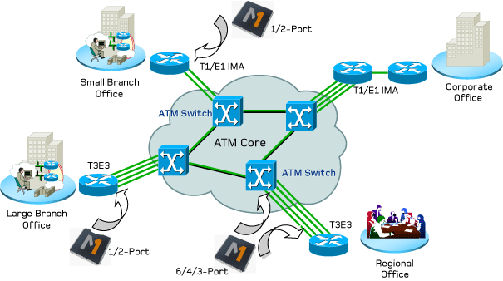

6) Network Routing & ISPs
Section Topics
Internet Service Provider (ISP)
Internet Connection Technologies
Network Routers & Switches
Section done by Harman Goraya
Networks
Home

Slide 26

6.1) Internet Service Providers (ISPs)
What is an ISP?
Stands for Internet Service Provider
Company that provides Internet access by using copper, fiber, or satellite communications
What are some common ISPs people use in the Toronto Area?
Rogers
Bell
VMedia
How is an ISP different from a Internet application / service?
ISP provides internet and an internet application/service allows you to buy stuff online
Need a ISP to go to an internet application
Networks
Home

Slide 27
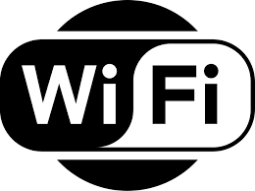
6.2) Internet Connection Technologies
Describe some internet connection technologies using telephone lines.
Dial-up internet access allows users to connect to internet when the modem is connected to the PC; computer dials a phone number and connects to network
Describe some internet connection technologies using Wi-Fi.
Wireless internet enable wireless connectivity to internet via radio waves
Used on computers, laptops, smartphones, or other similar devices
Describe some internet connection technologies using fibre optics cables.
Internet, television, telephone, computer networking, and mechanical inspections all using fibre optics cables
Networks
Home

Slide 28
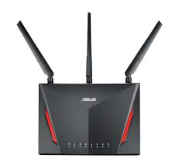
6.3) Network Routers & Switches
What is a "Routing Table"?
Set of rules that is used to determine where data packets travelling over an internet protocol network will be directed
Contains the information necessary to forward a packet along the best path towards its destination
How are data packets sent through the internet between a client and a server?
Network breaks an e-mail message into parts, for ex, and of a certain size in bytes
Packet carries information that will help get to its destination
Packets carries data in protocols that internet uses: Transmission Control Protocol/Internet Protocol(TCP/IP)
What special hardware & software is required for a network router / switch?
Internet Modem, Ethernet Hub/Switch, Wireless Router
Networks
Home

Slide 29
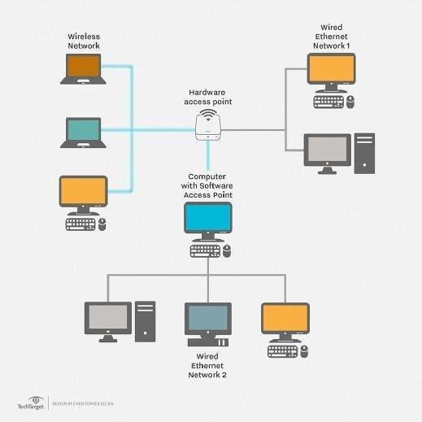
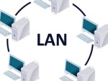
7) Types of Networks
Section Topics
Local Area Networks (LAN)
Wide Area Networks (WAN)
Virtual Private Networks (VPN)
Section done by Harman Goraya
LANs
Home

Slide 30
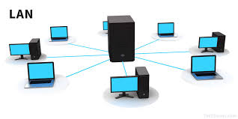
7.1) Local Area Networks (LAN)
What is a Local Area Network?
Computer network interconnects computers within a limited area such as a residence, school, laboratory, university campus, or office building
What is the purpose of a Local Area Network?
Allows users to connect their computers to a common server or servers
Allows everyone to work on the same document
What types of applications, servers, and computers are connected to a LAN?
School computers, university campuses, work places
Game servers
Google Docs/Slides
LANs
Home

Slide 31
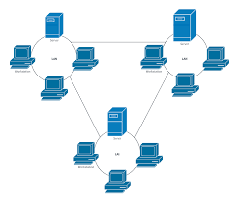
7.2) Wide Area Networks (WAN)
What is a Wide Area Network?
Telecommunications network that extends over a large geographical distance for the primary purpose of computer networking
What is the purpose of a Wide Area Network?
Transporting data, voice, and video
Usually owned by an organization
What types of applications, servers, and computers are connected to a WAN?
School Networks are usually using WAN
Work Companies may also use WAN
LANs
Home

Slide 32

7.3) Virtual Private Networks (VPN)
What is a Virtual Private Network?
Extends a private network across a public network
Enables users to send and receive data across shared or public networks
How is a VPN different from a LAN / WAN?
LAN and WAN are usually used for school or work networks
VPNs give you IP Addresses
How could you use a VPN to increase the security of services you use in the Internet?
VPN lets you increase the security of your web session, transmitted data, financial transactions and personal info.
Also hides your IP Address, making it harder for third-parties to track you
LANs
Home

